Slide 1
Online voting system
EXERCISE NO :15

Slide 2
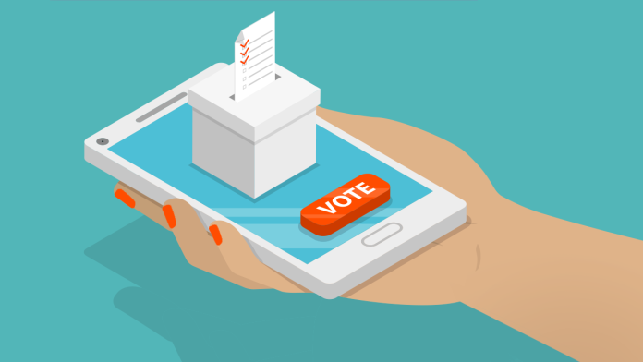
The future of democracy is digital."
""Voting is not only our right, it is our power."
"The ballot is stronger than the bullet."
""The vote is precious. It is almost sacred. It is the most powerful non-violent tool we have in a democratic society."

Slide 3

Accessibility: Online voting systems allow voters to cast their votes from anywhere, at any time, using a computer or mobile device with an internet connection. This increases voter accessibility, especially for those who have difficulty traveling to a polling station.
Security: Online voting systems have robust security measures to ensure that the voting process is safe and secure. These security measures include encryption, multi-factor authentication, and monitoring systems to detect and prevent hacking or fraud.
Transparency: Online voting systems offer transparency and auditability of the voting process. The system should allow for the verification of votes cast and the ability to track any changes made to the voting records.

Slide 4
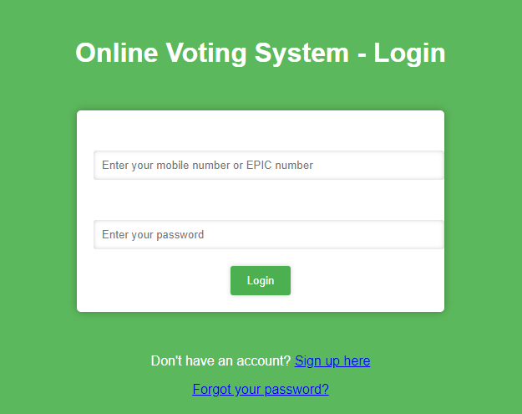
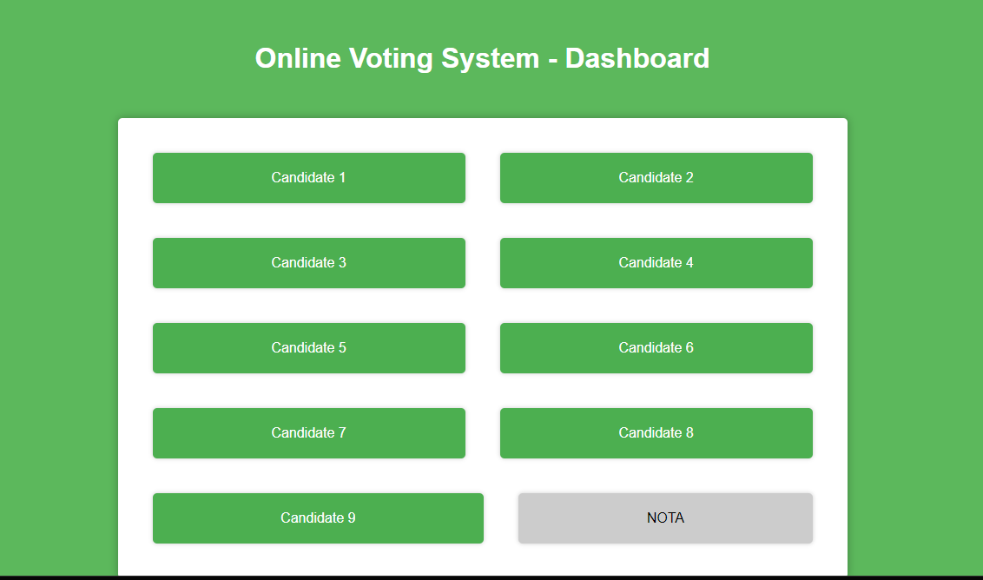
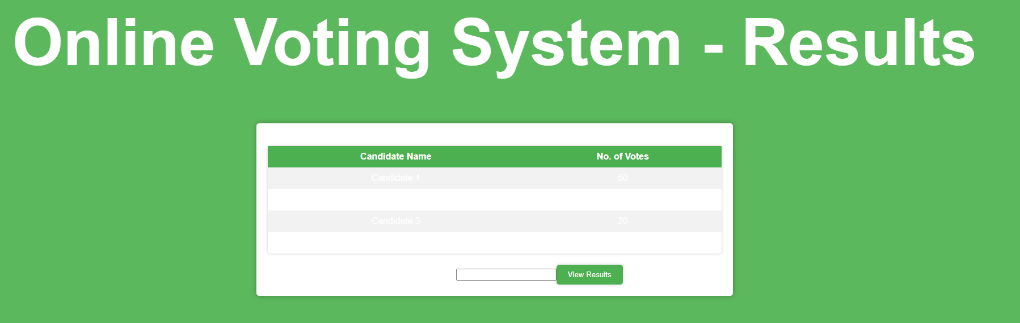
The Login System Will Be

Slide 5


